Slide 1
SPI COMMUNICATION WITH SPARROW BOARD
VISHWA TEJA REDDY
B.Tech(ECE)
Intern

Slide 2
Specifications
Using maximum Data From DDR memory to write and Read
Write and Reading Registers of AFE at 20MHz frequency using Interface
Writing and Reading data From registers continuously at 20MHz Frequency using SPI interface
Reading the Register data at 20MHz frequency Using SPI interface and updating this data to DDR and reading through Asterix using FX3 interface
Reading the FIFO data at 20MHz frequency Using SPI interface and updating this data to DDR and reading through Asterix using FX3 interface

Slide 3
Agenda
Arevo2p0 code is used to establish communication between Asterix and the Sparrow board.
Using the test pattern included in the arevo2p0 code, test and verify the asterix setup.
Find out how much DDR memory the previous code was using and increase it as much as possible.
Understanding SPI lines and how data loads in SPI communication requires reading AFE.
For the AFE, provide a standard Register read SPI module.
Including delay adjustment options in standard SPI mode.
Make a FIFO SPI mode that reads data constantly for the specified SPI cycles.
Similar delay settings should be added for this mode.
Remove any unusable blocks before adding these modules to the Arevo code. Utilise an oscilloscope to validate and test devices.
Using the data from SPI, write a block that can generate 128-bit padpacket data for DDR.
Through Asterix, confirm and test on hardware.
Block that reads continuous REG SPI data from AFE while using register addresses immediately following the completion of FIFO SPI with enable. SPI all reg and SPI fifo along with packet maker
All of these inputs are added in ADC RAW MODE in the Arevo2p0 code mux
Test and verify on hardware.

Slide 4
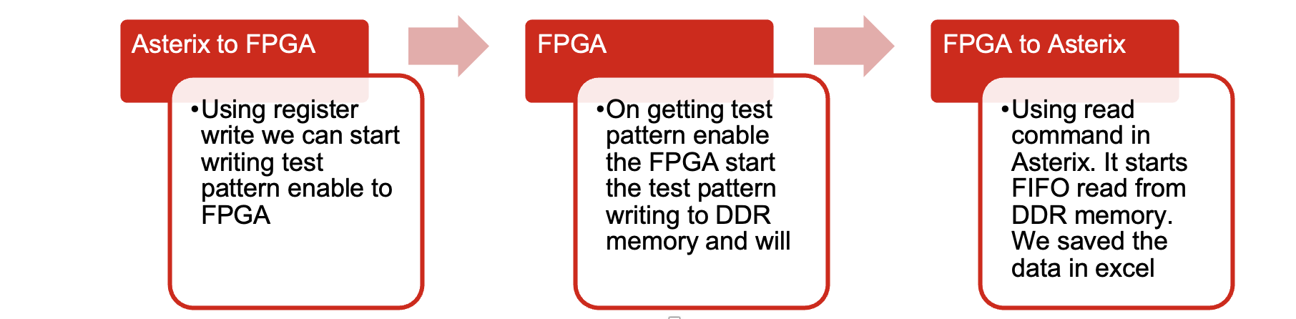
Asterix Set Up
We programmed the FPGA using arevo2p0 and the given bitstream files, then went to Asterix and sent commands to read data from the sparrow DDR memory.
An incorporated test pattern that provides a ramp up with synchronised clock is available for setup verification.
With pre-encoded fifo read depth and write depth, we were able to read and write around 6Mb of data from the DDR memory.

Slide 5
Maximum Capacity DDR
We are using MT41K64M16TW-107 AAT:j, a micron technology chip with a 1Gb density, as our built-in DDR3 memory.
We want to use more of the DDR3 memory, which has a maximum capacity of 1024Mb, so we're going to raise the read and write depths.
We changed the read depth and write depth, and the highest amount of data we could use was 1020Mb. We utilised a ramp pattern for verification to demonstrate that we are utilising the entire RAM.
6Mb
1020Mb

Slide 6
Asterix output and observations
In the extracted excel file we observed that there is a loss of a 16 bit packet data in the asterix because of the arevo2p0 code. We need to deal with it and
In the above picture is when the test pattern is written into DDR memory, we can observe that first packet of 0 is missing.
0 | 0 | 0 | 0 | 0 | 0 | 0 | 0 | 1 | 0 | 1 | 0 | 1 | 0 | 1 | 0
128 | 0 | 128 | 0 | 128 | 0 | 128 | 0 | 129 | 0 | 129 | 0 | 129 | 0 | 129 | 0
256 | 0 | 256 | 0 | 256 | 0 | 256 | 0 | 257 | 0 | 257 | 0 | 257 | 0 | 257 | 0
384 | 0 | 384 | 0 | 384 | 0 | 384 | 0 | 385 | 0 | 385 | 0 | 385 | 0 | 385 | 0
512 | 0 | 512 | 0 | 512 | 0 | 512 | 0 | 513 | 0 | 513 | 0 | 513 | 0 | 513 | 0

Slide 7
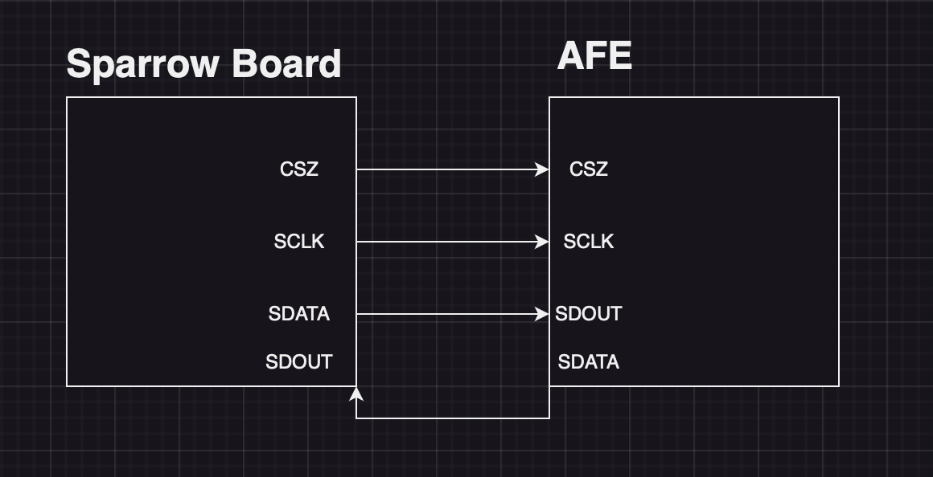
SPI COMMUNICATIN and LINES
As in the above block we are planning a SPI comm lines from Sparrow board to AFE with FIFO interrupts and REG interrupts.

Slide 8
AFE
There are two methods of SPI communication, as shown by the AFE data sheet. Register spi and fifo spi both use the same SPI lines in AFE, however fifo spi has two SPI communication depending on which AFE we are using.
Therefore, register SPI is just regular SPI that employs a register interrupt pin before beginning the transmission and uses 24 bit data and 16 bit address bits.
A 16-bit register with a fifo interrupt is sent out before communication, and the fifo has 24 bit data as well. There are pace fifo and main fifo, and the addresses for each are distinct.
For reading the Main FIFO, the address should be set to xx00001111111111, and for reading the PACE FIFO, it should be set to xx00001111111110, where the first two bits stand for the Chip address.
In below slide there are timing diagrams for both the FIFO read and REG read.
In the first 24 bit data of fifo SPI we get the pointer difference that we got from AFE and we will be using that to continuously read data from the FIFO.

Slide 9
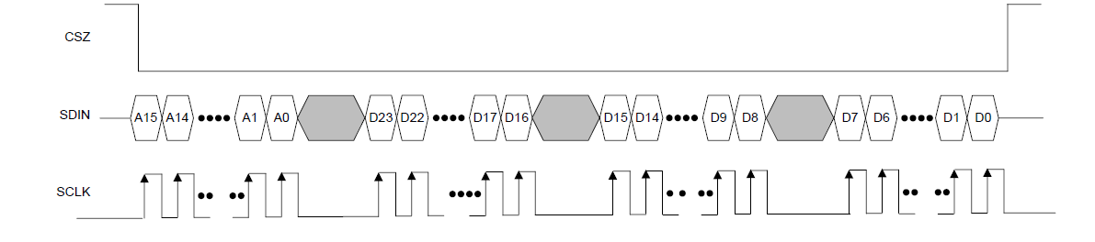
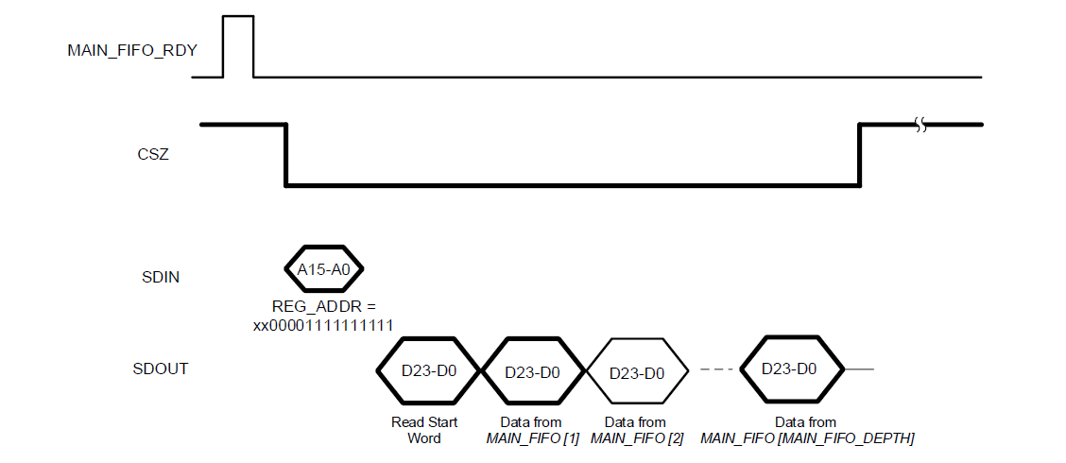
Timing Requirements to AFE
The timing diagrams for the REG SPI and FIFO SPI
Reg spi SDIN is sampled at posedge of SCLK and SDOUT is stable at posedge
FIFO spi gives data of 24 bit data continuously upto pointer difference

Slide 10
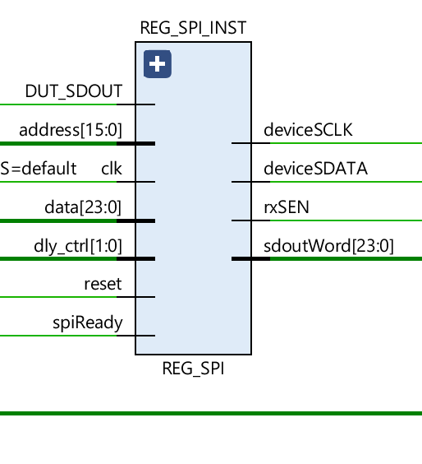
REG SPI BLOCK
Normal Register write and Read
Address 16 bit given by Reg 34[15:0]from Regmap
Data 24 bit given by Reg 35[23:0] from Regmap
Delay_ctrl is given by Reg26[1:0]
SpiReady given by Reg26[2]
Reset from Reset system
Clk is clk_SPI(20Mhz clk)
Device SCLK is not of clk_SPI(20MHz clk)
rxSEN is chip select
Write enable is not attached here

Slide 11
REG SPI with Requirements of AFE
We implemented a REG SPI with Reg spi mode using below state machine
If there is interrupt
Update the state to transmit spi
Count to 40
Spiword to address and data
Start sdoutword
WaitForInterupt
TransmitSPI
If there is no interrupt
Keep state as same
Update count to 40
Msb bit to 39
Write enable to 0
Csz as high
If count is non zero
Make csz low
Make Sclk=~clk
Use sdoutword as shift register
Pad sdout
Send sdata from shift register
Spiword
Couunt=count-1
If the count is 0
Update the state to waitforinterupt
Make CSZ hiigh
Count to 40
Update sdoutWord from internal
Keep write enable = 1

Slide 12
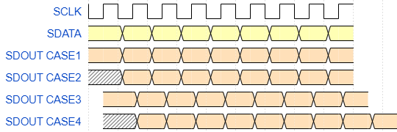
Problems with SPI lines with Delay
We know there may be issues regarding delays from AFE the data may be reached late to the SPI line so we take care of these 4 challenges in the SPI communication. The 4 adjustments are given below

Slide 13
REG SPI State machine with delay adjustments
We implemented a REG SPI with Reg spi mode using below state machine
If there is interrupt
Update the state to transmit spi
Count to 40
Spiword to address and data
Start sdoutword, for delay case 3 and 4
Add statedly but make csz low soon so
That afe starts sendig data.
WaitForInterupt
TransmitSPI
If there is no interrupt
Keep state as same
Update count to 40
Msb bit to 39
Write enable to 0
Csz as high
No delay required
If count is non zero
Make csz low
Make Sclk=~clk
Use sdoutword as shift register
Pad sdout
Send sdata from shift register
Spiword
Couunt=count-1
For cases delay 2 and 4
Depending which edge we need
To latch or smaple the data
Keep always@ as posedge or
Negedge.
If the count is 0
Update the state to waitforinterupt
Make CSZ hiigh
Count to 40
Update sdoutWord from internal
Keep write enable = 1
No delay required

Slide 14
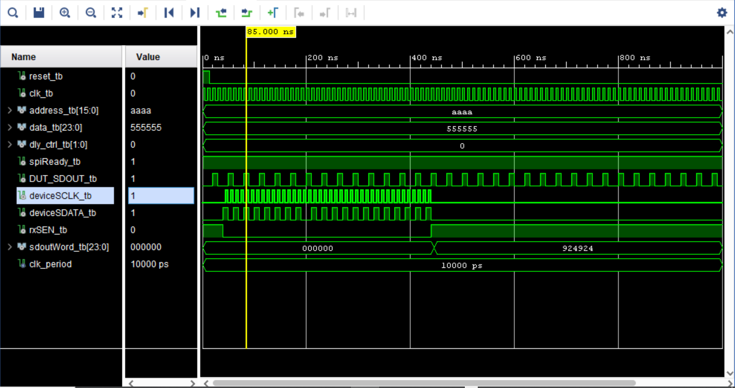
Results for 00 delay control

Slide 15
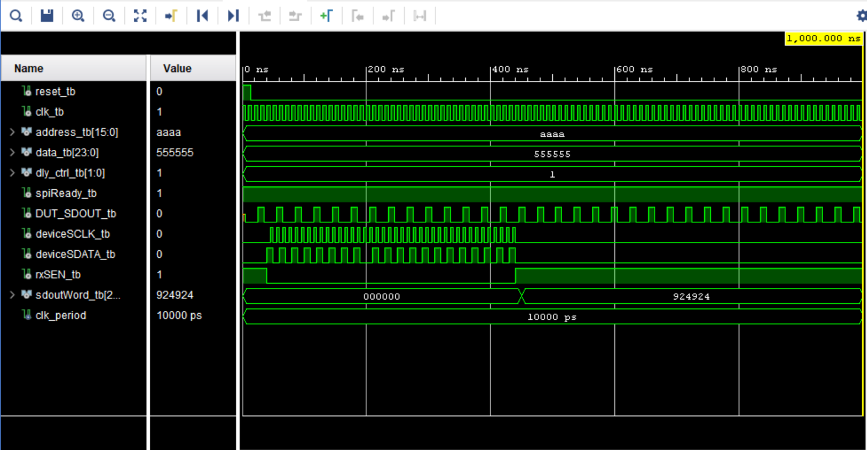
Results for 01 delay control

Slide 16
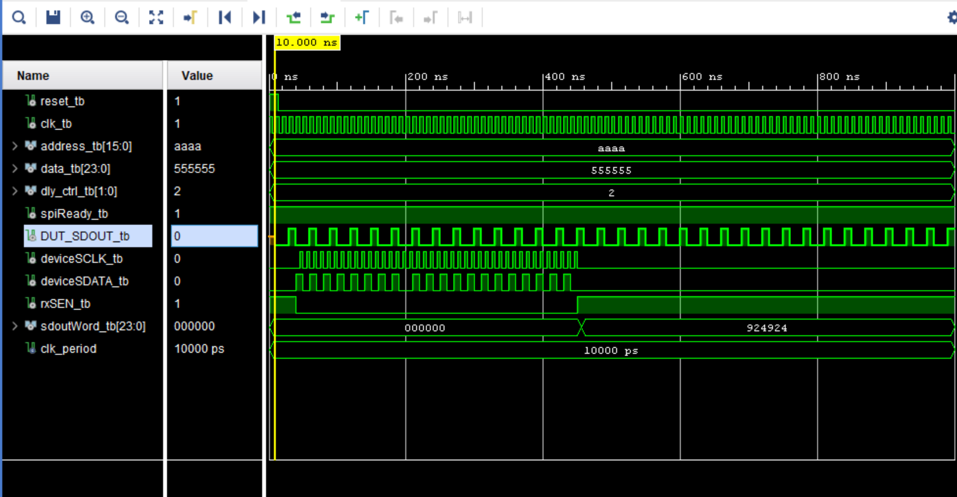
Results for 10 delay control

Slide 17
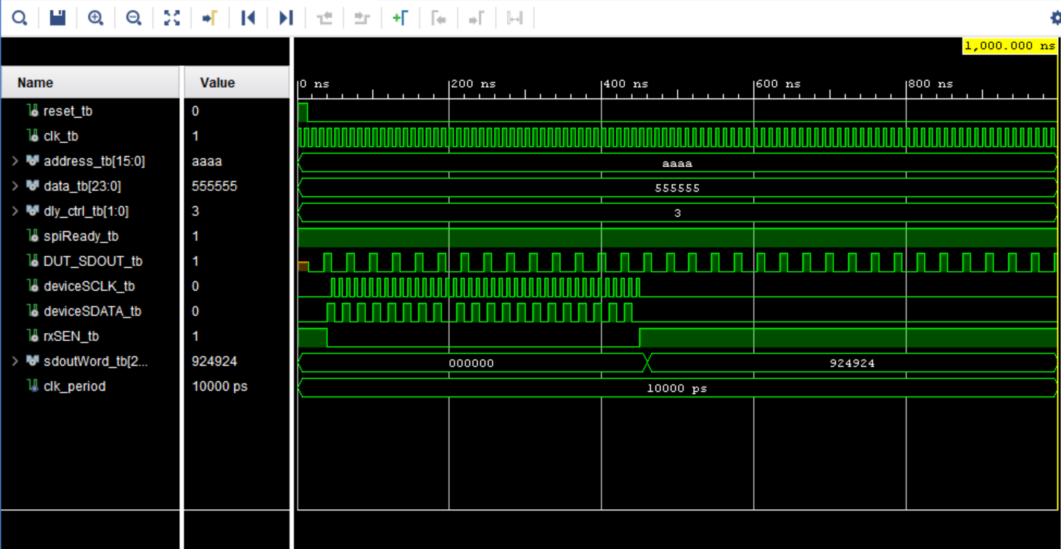
Results for 11 delay control

Slide 18
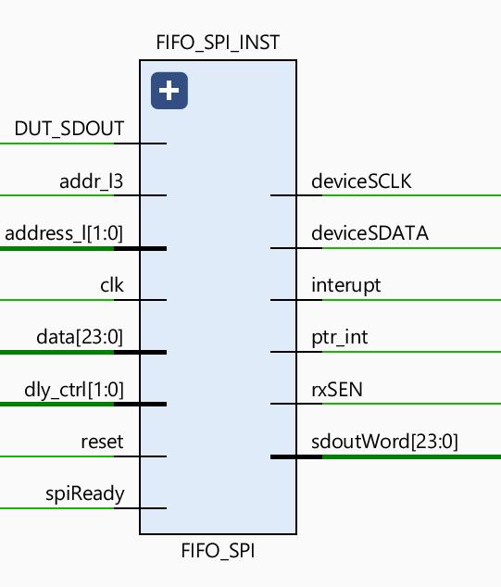
FIFO SPI BLOCK
FIFO SPI for Read FIFO Data
Address 16 bit given by address_l(information about AFE) and addr_l3 (information about Main or Phase FIFO)
Address_l from Reg26[4:5] and Addr_l3 from Reg26[3]
Data 24 bit given by Reg 26[31:8] from Regmap (no use)
Delay_ctrl is given by Reg26[1:0]
spiReady is given by output pin FIFO_int
Reset from Reset system
Clk is clk_SPI(20Mhz clk)
Device SCLK is not of clk_SPI(20MHz clk)
rxSEN is chip select
Ptr_int gives interrupt when sdoutword has pointer difference
Interupt is up when sdoutWord is Ready to read

Slide 19
FIFO SPI with Requirements of AFE
We implemented a REG SPI with Reg spi mode using below state machine
If there is no interrupt
Keep state as same
Update count to 40
Msb bit to 39
Write enable to 0
Csz as high
WaitForInterupt
If there is interrupt
Update the state to transmit spi
Count to 40
Spiword to address and data
Start sdoutword, for delay case 3 and 4
Add statedly but make csz low soon so
That afe starts sendig data.
If count is non zero
Make csz low
Make Sclk=~clk
Use sdoutword as shift register
Pad sdout
Send sdata from shift register
Spiword
Couunt=count-1
Update pointer difference
For cases delay 2 and 4
Depending which edge we need
To latch or smaple the data
Keep always@ as posedge or
Negedge.
If count is non zero
Make csz low
Make Sclk=~clk
Use sdoutword as shift register
Pad sdout
Send sdata from shift register
Spiword
Couunt=count-1
Update pointer difference
For cases delay 2 and 4
Depending which edge we need
To latch or smaple the data
Keep always@ as posedge or
Negedge.
If the count is 0 and pointer diff is 0
Update the state to waitforinterupt
Make CSZ hiigh
Count to 40
Update sdoutWord from internal
Keep write enable = 1
No delay required
continuousTransmitSPI
TransmitSPI
If pointer difference is non zero
Update Count = 24.
State to continuous transmit

Slide 20
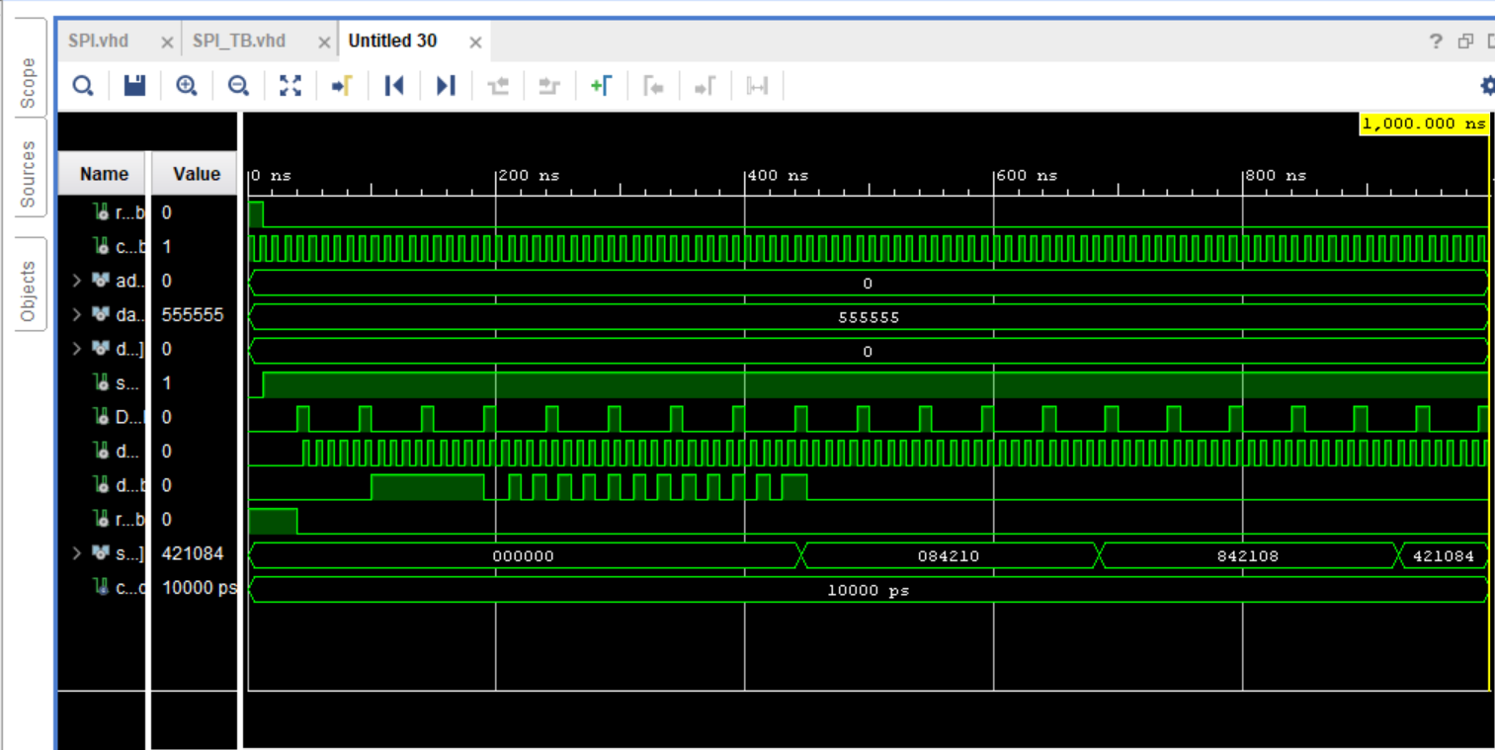
Results for 00 delay control of burst

Slide 21
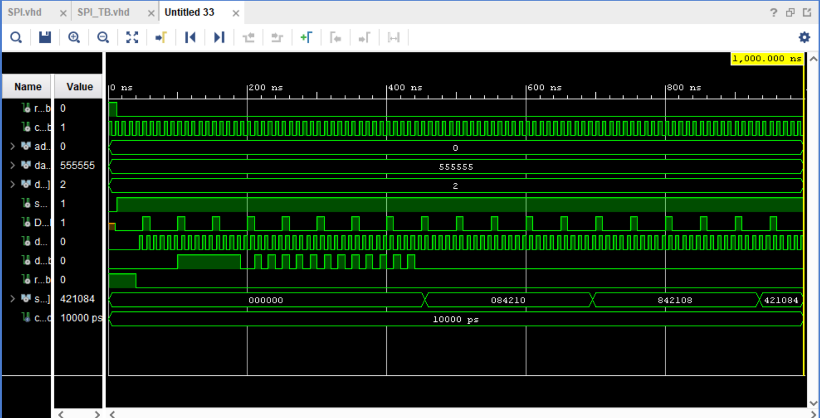
Results for 01 delay control of burst

Slide 22
Results for 10 delay control of burst

Slide 23
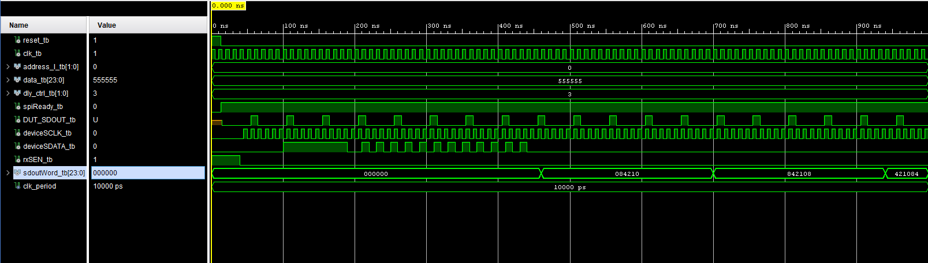
Results for 11 delay control of burst

Slide 24
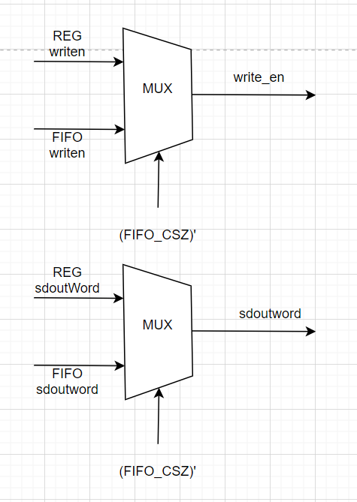
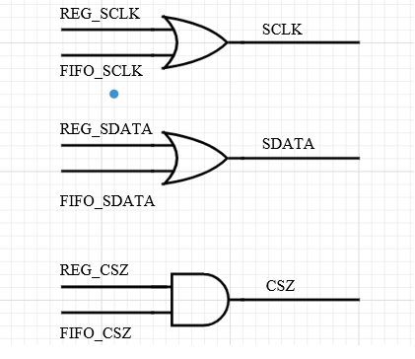
Adding FIFO and REG block separately
We Muxed the output of SdoutWord
We muxed the output of write en
We or’ed the SCLK
We and’ed the CSZ
We or’ed the SDATA

Slide 25
Now implementing SPI on Sparrow and Testing using test pins inside Sparrow
TP_BUS14_2p5_1-P19-SCLK-2
TP_BUS14_2p5_2-R19-SDATA-3
TP_BUS14_2p5_3-T20-SDOUT-4
TP_BUS16_2p5_1-C14-CSZ-5
TP_BUS16_2p5_2-C15- FIFO_int-6
TP_BUS16_2p5_3-E13- REG_int-7
Above shown are test inputs on giving the pulses to the SDOUT and interupt in from signal generator
Observing the SDATA and SCLK in DSO given below results

Slide 26
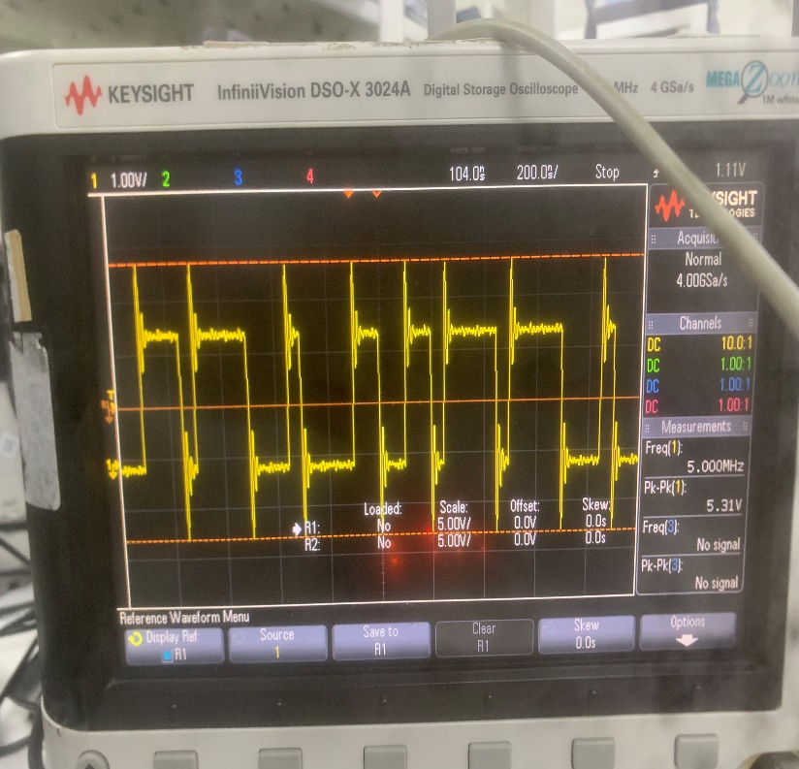
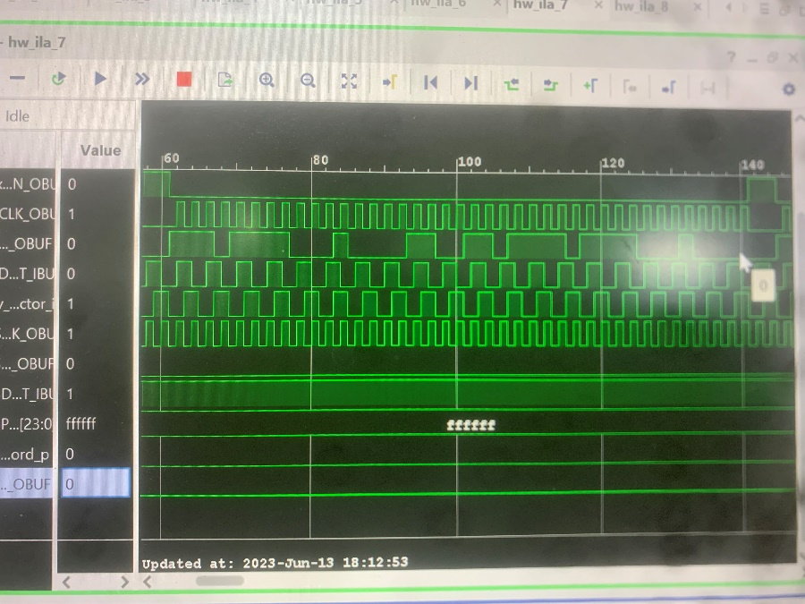

Ressults of SDATA on REG SPI

Slide 27
Now merging Both FIFO and REG spi lines and testing the data SCLK out and SDATA
TP_BUS14_2p5_1-P19-SCLK-2
TP_BUS14_2p5_2-R19-SDATA-3
TP_BUS14_2p5_3-T20-SDOUT-4
TP_BUS16_2p5_1-C14-CSZ-5
TP_BUS16_2p5_2-C15- FIFO_int-6
TP_BUS16_2p5_3-E13- REG_int-7
Above shown are test inputs on giving the pulses to the SDOUT and FIFO interupt in from signal generator
Observing the SDATA and SCLK in DSO given below results

Slide 28
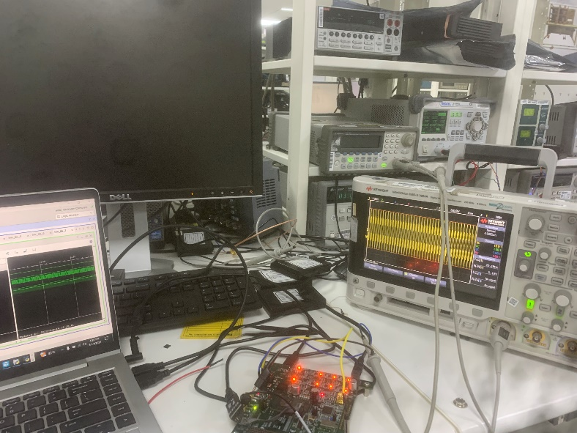
Results of SCLK when fifo is interupted

Slide 29
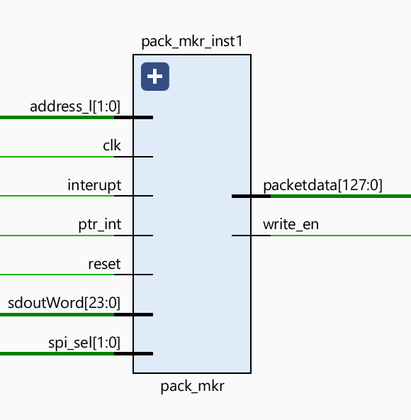
Pack maker inst
This block is used for efficiently pad SPI sdoutword to fill 128 bit data which is pre coded inside arevo to write into DDR memory
Address_l comes from Reg26[5:4]
Sdoutword,Interupt and ptr_int will be dependent on FIFO SPI outputs for now
Reset normal internal rst_sys
SPI_sel is pre coded data depending on which data we are reading will discuss briefly in DATA_SPI block
Packetdata(8->header,SPIdata)

Slide 30
Pad packet data for FIFO
Instead of padding the data with all zeros and sending it to the DDR memory in the Arevo, we came up with the idea of padding the data from 5 spi with header to make it 128 bit data.
Our header is constructed so that the first two bits provide information about AFE, the following two bits contain information about the SPI we are using, and the following bit has information about count and pointer difference.
Next 120 bits will give SPI Data, for this PAD to work we made changes in fifo such that we get pointer interrupts and interrupts.
Which give info as pad the sdoutword that present at that instant

Slide 31
State machine
Wait for ptr interupt
WaitForptrinterupt
Update count by 5
Wait for interupt
If counter is 0 or ptr diff is 0 then give interrupt and submit the 128 bit data
WaitForInterupt
padSPI
Pad SPI sdoutwrod data
Reduce pointer by 1 and reduce counter by 1
Wait for interupt

Slide 32
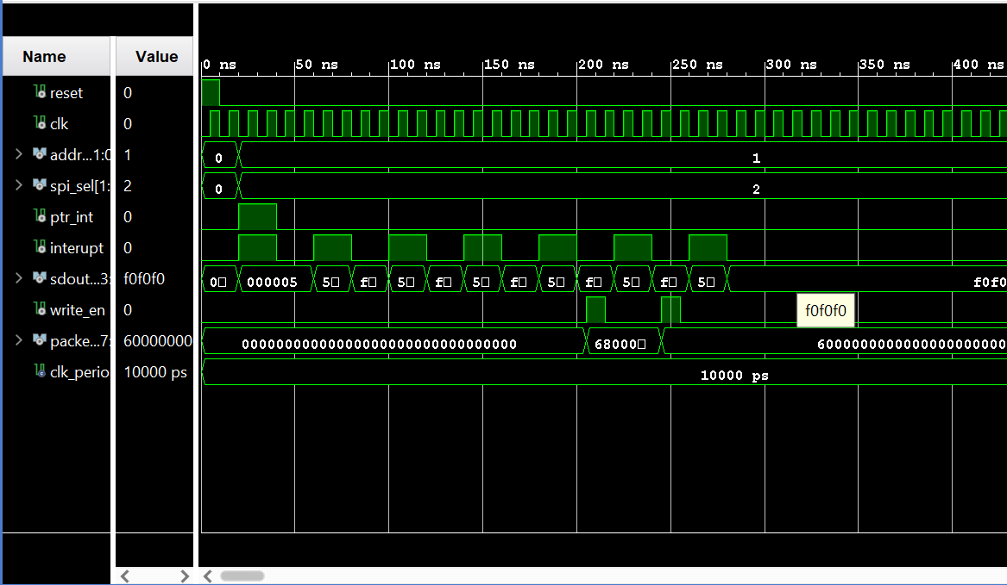
Vivado simulation Results
When the pointer difference is 5 with data as all 555555

Slide 33
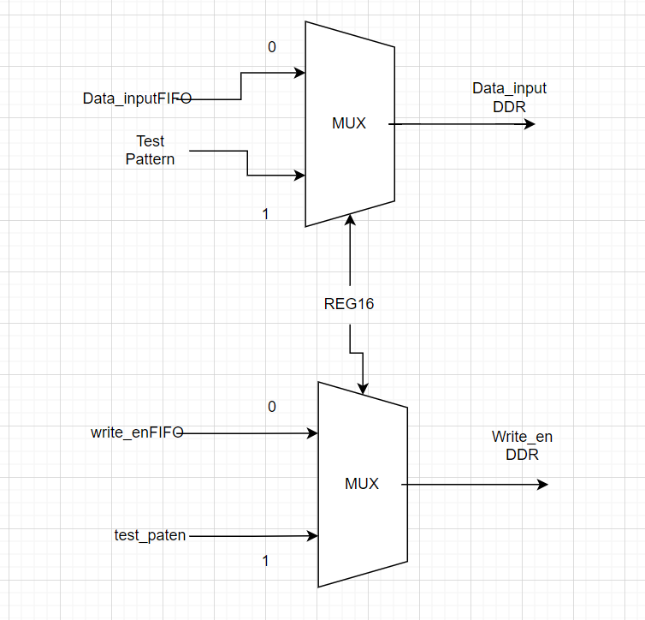
Integrating with sparrow code
To write into DDR we muxed the Test pattern with our data input FIFO
Data input fifo is the data coming out from packet maker because of only FIFO
If Reg16 is 0 then the FIFO data is inside the DDR block input
If Reg 16 is 1 Then the inbuilt test pattern which is ramp up is initiated and written in DDr top

Slide 34
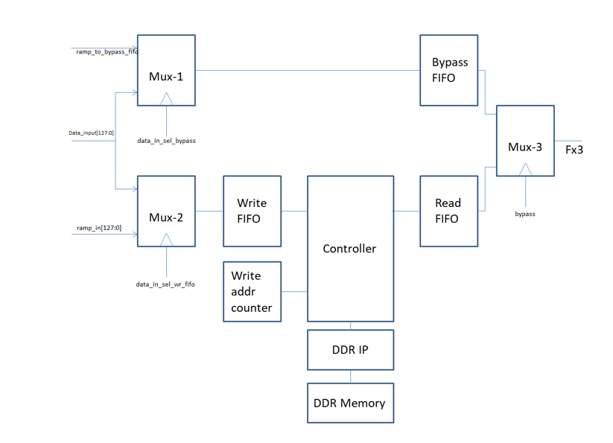
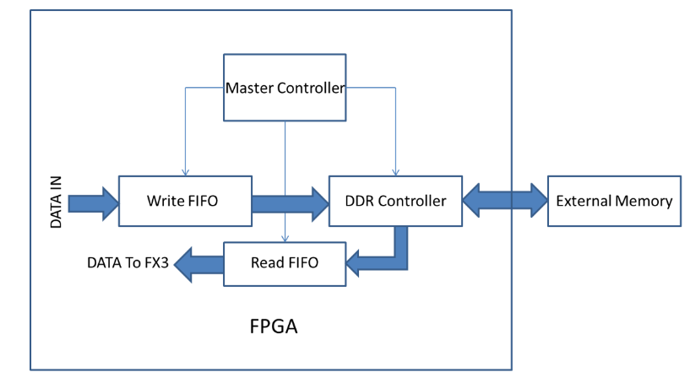
DDR TOP
The Arevo uses above DDR top module to Write into DDR and Read into DDR all the signals are given from Asterix to control the writing and Reading the DDR depth captures

Slide 35
Asterix TEST results with resolving previous error
As the data_out is updated at clk_sys every time we missded the first 16 bit data initially, so I added a delay of clk_sys so now we are able to capture the initial data also.
DA | TA | RE | AD | TO | AS | TE | Rix |  | He | xD | AT | A
51200.00 | 5.00 | 21845.00 | 21845.00 | 21845.00 | 21845.00 | 21845.00 | 21845.00 |  | C800 | 0005 | 5555 | 5555 | 5555 | 5555 | 5555 | 5555
49152.00 | 0.00 | 0.00 | 0.00 | 0.00 | 0.00 | 85.00 | 21845.00 |  | C000 | 0000 | 0000 | 0000 | 0000 | 0000 | 0055 | 5555
51200.00 | 5.00 | 21845.00 | 21845.00 | 21845.00 | 21845.00 | 21845.00 | 21845.00 |  | C800 | 0005 | 5555 | 5555 | 5555 | 5555 | 5555 | 5555
49152.00 | 0.00 | 0.00 | 0.00 | 0.00 | 0.00 | 85.00 | 21845.00 |  | C000 | 0000 | 0000 | 0000 | 0000 | 0000 | 0055 | 5555

Slide 36
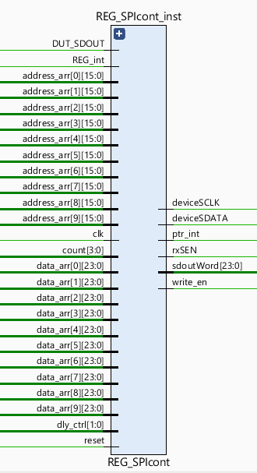
Works on posedge of REG_int once started it won’t search for REG_in
10 address array and 10 data arrar are benn used
Delay_ctrl is given by Reg26[1:0]
spiReady is given by output pin FIFO_int
Reset from Reset system
Clk is clk_SPI(20Mhz clk)
Device SCLK is not of clk_SPI(20MHz clk)
rxSEN is chip select
Ptr_int gives interrupt when sdoutword has count of REG SPI difference
Write_en is up when sdoutWord is Ready to read

Slide 37
Continuous REG read block
As for the request we created a continuous register read block that will take address array from registers and data from registers
It will start reading the data from that addresses with provided count times and update sdoutword with an interrupt to let read the data.
Continuous register block uses our previous reg block and update the addresses and sdout came from them depending on the logic we wrote
assign address_arr[0] = Reg29[15:0];
assign address_arr[1] = Reg29[31:16];
assign address_arr[2] = Reg30[15:0];
assign address_arr[3] = Reg30[31:16];
assign address_arr[4] = Reg31[15:0];
assign address_arr[5] = Reg31[31:16];
assign address_arr[6] = Reg32[15:0];
assign address_arr[7] = Reg32[31:16];
assign address_arr[8] = Reg33[15:0];
assign address_arr[9] = Reg33[31:16];
assign data_arr[0] = Reg12[23:0];
assign data_arr[1] = Reg14[23:0];
assign data_arr[2] = Reg15[23:0];
assign data_arr[3] = Reg17[23:0];
assign data_arr[4] = Reg18[23:0];
assign data_arr[5] = Reg19[23:0];
assign data_arr[6] = Reg20[23:0];
assign data_arr[7] = Reg21[23:0];
assign data_arr[8] = Reg22[23:0];
assign data_arr[9] = Reg23[23:0];

Slide 38
State Machine
After interrupt
update counter from input
Start first Regint to REG SPI
Count reduce by 1
WaitForREGint
WaitForint
Wait for ptr interrupt
Wait for ptr interrupt
For every rising edge of Reg interrupt done
Update address
Update sdout word
Update write_en_int
Update count = count-1 until count is non ‘0’
If Count is 0
Update sdoutword previously
Update new state
Stop Reg int
Adress update complete.

Slide 39
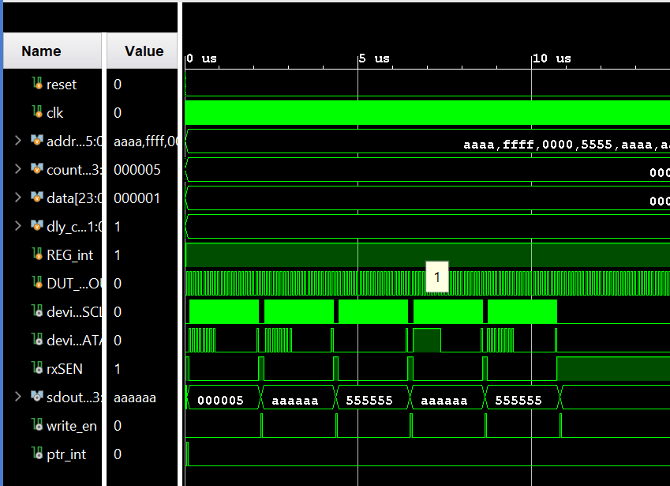
Vivado simulation Results

Slide 40
Merging all SPI and pad packet data
We wanted to merge all the SPI and pad packet data and make a data_SPI block which provides us with the FIFO data REG data conditionally.
If we want to read Reg data then we need to keep REG_en as high depending on the count it will give out the interrupts and the pttr interrupts and sdoutword.
So as in case by muxing all the data and assigning it to packet data provides us the merging packets of all data with relevant headers so that the computer will understand which data is which.
Below is the state diagram for the data SPI block

Slide 41
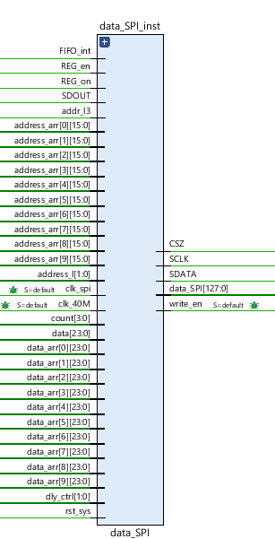
DAT SPI BLOCK
Same registers for fifo and others
Extra we added are REG_en and REG_on
Reg_en is 1 for if you want to read or write data to registers continuously after FIFO is done
Reg_on is only if you want to write or read the continuous Register data not including FIFO

Slide 42
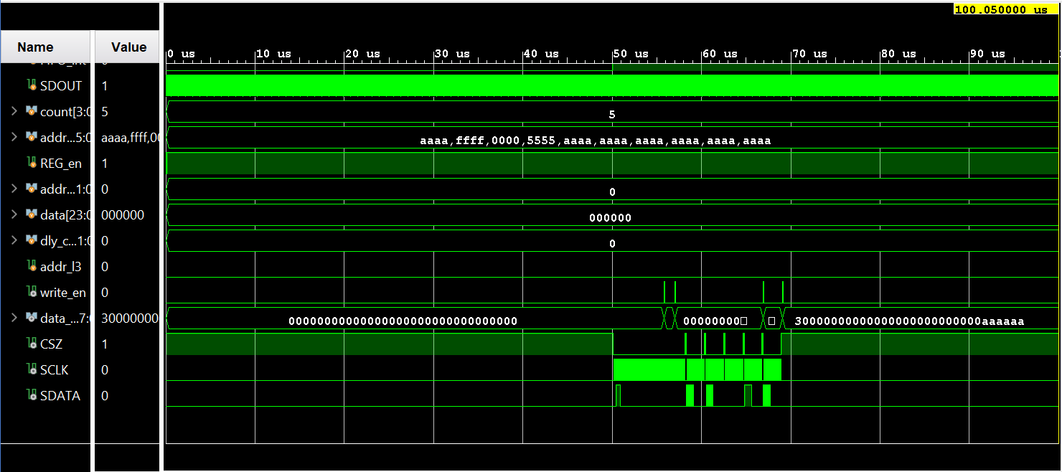
Vivado Simulation Results

Slide 43
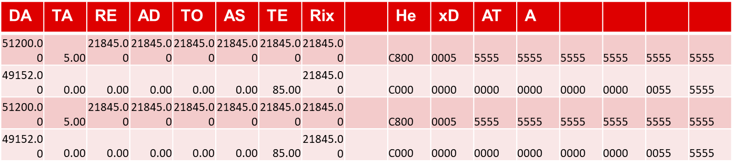
Asterix Test Results
FIFO DATA
REG DATA
2048 | 5 | 65535 | 65535 | 65535 | 65535 | 65535 | 65535 | FIFO-AFE00 | 800 | 5 | FFFF | FFFF | FFFF | FFFF | FFFF | FFFF
0 | 0 | 0 | 0 | 0 | 0 | 255 | 65535 | FIFO-AFE00 | 0 | 0 | 0 | 0 | 0 | 0 | FF | FFFF
14336 | 5 | 65535 | 65535 | 65535 | 65535 | 65535 | 65535 | REG | 3800 | 5 | FFFF | FFFF | FFFF | FFFF | FFFF | FFFF
12288 | 0 | 0 | 0 | 0 | 0 | 255 | 65535 | REG | 3000 | 0 | 0 | 0 | 0 | 0 | FF | FFFF

Slide 44
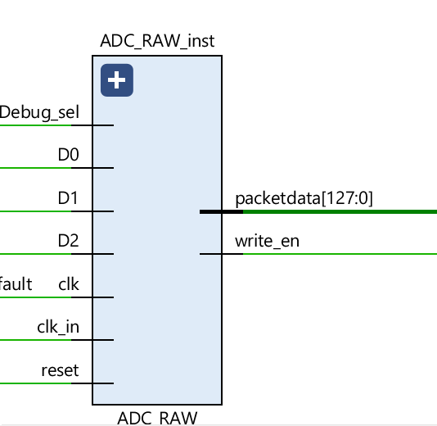
ADC RAW MODE BLOCK
ADC RAW mode work on Debug SEL
When debug sel is high ADC will start padding the data when it fills all the 128 bits it is updated and given write_en
D0,D1,D2, clk_in are coming from GPIO pins of AFE
Clk which we are using here is 40MHz clock

Slide 45
ADC raw Mode
AFE gives data D0 D1 and D2 with 2MHz clock from the AFE.
We need to write this data to the 128 bit packet by same process of padding.
We padded them as D2,D1,D0 in order and pad all this data and there is a header to this raw mode data.
We made a separate block for RAW mode data packet block after filling the 128 bit data then there will be interrupt for reading this packet data

Slide 46
State Machine
After interrupt
Count to 40
Get DATA
WaitForREGint
padDATA
Wait for ptr interrupt
For every rise edge of clock sample the data D0,D1,D2
Update count as count -1
Update this data to shift registers in order
If count is non 0
If Count is 0 or REG_int is Low
Update new state
Update packet data of 128 bits
Update write en for DDR in fifo

Slide 47
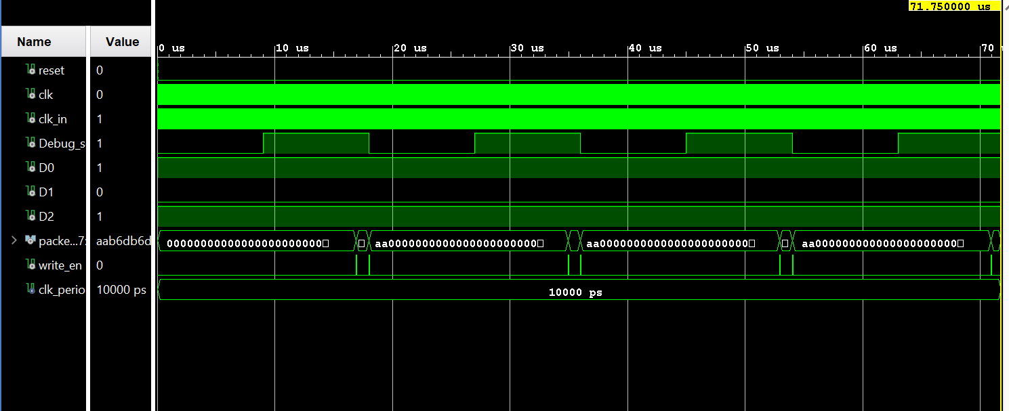
Vivado Simulation Results

Slide 48
Asterix Test Results
Normal test data generated from AWG
4.37E+04 | 5.62E+04 | 4.68E+04 | 2.81E+04 | 5.62E+04 | 4.68E+04 | 2.81E+04 | 5.62E+04 |  | AAB6 | DB6D | B6DB | 6DB6 | DB6D | B6DB | 6DB6 | DB6D
4.37E+04 | 5.62E+04 | 4.68E+04 | 2.81E+04 | 5.62E+04 | 4.68E+04 | 2.81E+04 | 5.62E+04 |  | AAB6 | DB6D | B6DB | 6DB6 | DB6D | B6DB | 6DB6 | DB6D
4.37E+04 | 5.62E+04 | 4.68E+04 | 2.81E+04 | 5.62E+04 | 4.68E+04 | 2.81E+04 | 5.62E+04 |  | AAB6 | DB6D | B6DB | 6DB6 | DB6D | B6DB | 6DB6 | DB6D
4.37E+04 | 5.62E+04 | 4.68E+04 | 2.81E+04 | 5.62E+04 | 4.68E+04 | 2.81E+04 | 5.62E+04 |  | AAB6 | DB6D | B6DB | 6DB6 | DB6D | B6DB | 6DB6 | DB6D

Slide 49
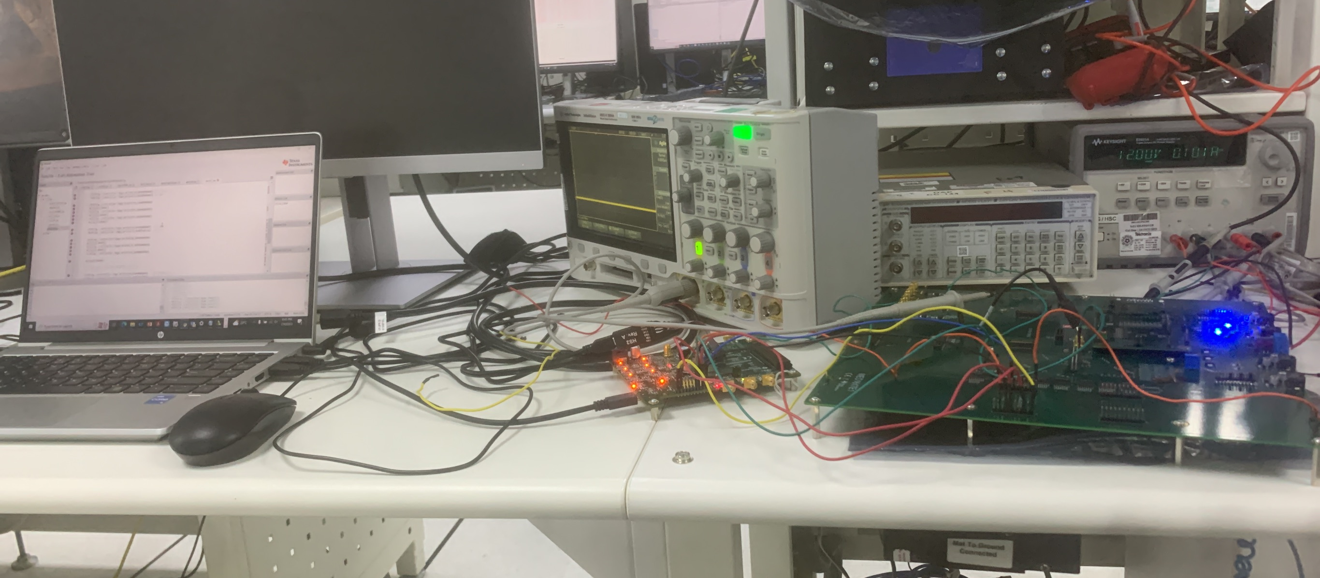
Integrating and testing with AFE

Slide 50
Testing Normal Register write and Read
We wrote to some of the registers and read the data at the same time and verified that it is working

Slide 51
Testing continuous Reg Write and Read to Asterix
14336 | 8 | 204 | 52224 | 43690 | 218 | 48128 | 52651 |  | 3800 | 8 | 00CC | CC00 | AAAA | 00DA | BC00 | CDAB
12288 | 0 | 219 | 51712 | 52666 | 188 | 55808 | 43981 |  | 3000 | 0 | 00DB | CA00 | CDBA | 00BC | DA00 | ABCD
14336 | 8 | 204 | 52224 | 43690 | 218 | 48128 | 52651 |  | 3800 | 8 | 00CC | CC00 | AAAA | 00DA | BC00 | CDAB
12288 | 0 | 219 | 51712 | 52666 | 188 | 55808 | 43981 |  | 3000 | 0 | 00DB | CA00 | CDBA | 00BC | DA00 | ABCD
14336 | 8 | 204 | 52224 | 43690 | 218 | 48128 | 52651 |  | 3800 | 8 | 00CC | CC00 | AAAA | 00DA | BC00 | CDAB
12288 | 0 | 219 | 51712 | 52666 | 188 | 55808 | 43981 |  | 3000 | 0 | 00DB | CA00 | CDBA | 00BC | DA00 | ABCD
14336 | 8 | 204 | 52224 | 43690 | 218 | 48128 | 52651 |  | 3800 | 8 | 00CC | CC00 | AAAA | 00DA | BC00 | CDAB
12288 | 0 | 219 | 51712 | 52666 | 188 | 55808 | 43981 |  | 3000 | 0 | 00DB | CA00 | CDBA | 00BC | DA00 | ABCD

Slide 52
Testing ADC data to Asterix
43747 | 36359 | 58254 | 2019 | 36359 | 58254 | 14367 | 36408 |  | AAE3 | 8E07 | E38E | 07E3 | 8E07 | E38E | 381F | 8E38
43744 | 32312 | 58254 | 14367 | 36408 | 58241 | 63715 | 36408 |  | AAE0 | 7E38 | E38E | 381F | 8E38 | E381 | F8E3 | 8E38
43747 | 36408 | 1009 | 50972 | 29127 | 7281 | 50972 | 4039 |  | AAE3 | 8E38 | 03F1 | C71C | 71C7 | 1C71 | C71C | 0FC7
43744 | 28735 | 8065 | 49404 | 32263 | 1009 | 63516 | 28728 |  | AAE0 | 703F | 1F81 | C0FC | 7E07 | 03F1 | F81C | 7038
43747 | 36408 | 58254 | 16131 | 36408 | 58254 | 14563 | 61496 |  | AAE3 | 8E38 | E38E | 3F03 | 8E38 | E38E | 38E3 | F038
43747 | 36408 | 64526 | 14563 | 36800 | 58353 | 63516 | 29176 |  | AAE3 | 8E38 | FC0E | 38E3 | 8FC0 | E3F1 | F81C | 71F8
43548 | 29127 | 57457 | 51168 | 29127 | 57457 | 51168 | 29176 |  | AA1C | 71C7 | E071 | C7E0 | 71C7 | E071 | C7E0 | 71F8
43548 | 29176 | 7294 | 2016 | 29127 | 58241 | 50972 | 32312 |  | AA1C | 71F8 | 1C7E | 07E0 | 71C7 | E381 | C71C | 7E38

Slide 53
Future work
N

Slide 54
Thank you

